Slide 1
RECETA EXTRA 2
Esta receta implica los siguientes pasos:
Imputación de valores faltantes
Identificación de outliers
Filtrado por grado de nubosidad
Normalización de datos en el rango 0-1.
Las librerías utilizadas son:
import pandas as pd
import numpy as np
import seaborn as sns
import matplotlib.dates as mdates
import matplotlib.pyplot as plt
import datetime
######
from pylab import rcParams
from statsmodels.tsa.seasonal import seasonal_decompose

Slide 2
El dataset utilizado está compuesto por 208.932 filas y 167 variables
# | Column | Non-Null Count | Dtype |  | # | Column | Non-Null Count | Dtype |  | # | Column | Non-Null Count | Dtype
--- | ------ | -------------- | -----
0 | B02_min | 167269 non-null | float64 |  | 56 | B11_min | 167262 non-null | float64 |  | 106 | VARIGreen_max | 167263 non-null | float64
1 | B02_max | 167269 non-null | float64 |  | 57 | B11_max | 167262 non-null | float64 |  | 107 | VARIGreen_mean | 167263 non-null | float64
2 | B02_mean | 167269 non-null | float64 |  | 58 | B11_mean | 167262 non-null | float64 |  | 108 | VARIGreen_median | 167263 non-null | float64
3 | B02_median | 167269 non-null | float64 |  | 59 | B11_median | 167262 non-null | float64 |  | 109 | VARIGreen_nodata | 208932 non-null | float64
4 | B02_nodata | 208932 non-null | float64 |  | 60 | B11_nodata | 208932 non-null | float64 |  | 110 | VARIGreen_range | 167263 non-null | float64
5 | B02_range | 167269 non-null | float64 |  | 61 | B11_range | 167262 non-null | float64 |  | 111 | VARIGreen_count | 208932 non-null | int64
6 | B02_count | 208932 non-null | int64 |  | 62 | B11_count | 208932 non-null | int64 |  | 112 | epichlb_min | 167263 non-null | float64
7 | B03_min | 167264 non-null | float64 |  | 63 | B12_min | 167262 non-null | float64 |  | 113 | epichlb_max | 167263 non-null | float64
8 | B03_max | 167264 non-null | float64 |  | 64 | B12_max | 167262 non-null | float64 |  | 114 | epichlb_mean | 167263 non-null | float64
9 | B03_mean | 167264 non-null | float64 |  | 65 | B12_mean | 167262 non-null | float64 |  | 115 | epichlb_median | 167263 non-null | float64
10 | B03_median | 167264 non-null | float64 |  | 66 | B12_median | 167262 non-null | float64 |  | 116 | epichlb_nodata | 208932 non-null | float64
11 | B03_nodata | 208932 non-null | float64 |  | 67 | B12_nodata | 208932 non-null | float64 |  | 117 | epichlb_range | 167263 non-null | float64
12 | B03_range | 167264 non-null | float64 |  | 68 | B12_range | 167262 non-null | float64 |  | 118 | epichlb_count | 208932 non-null | int64
13 | B03_count | 208932 non-null | int64 |  | 69 | B12_count | 208932 non-null | int64 |  | 119 | gari_min | 167260 non-null | float64
14 | B04_min | 167263 non-null | float64 |  | 70 | ndvi_min | 167260 non-null | float64 |  | 120 | gari_max | 167260 non-null | float64
15 | B04_max | 167263 non-null | float64 |  | 71 | ndvi_max | 167260 non-null | float64 |  | 121 | gari_mean | 167260 non-null | float64
16 | B04_mean | 167263 non-null | float64 |  | 72 | ndvi_mean | 167260 non-null | float64 |  | 122 | gari_median | 167260 non-null | float64
17 | B04_median | 167263 non-null | float64 |  | 73 | ndvi_median | 167260 non-null | float64 |  | 123 | gari_nodata | 208932 non-null | float64
18 | B04_nodata | 208932 non-null | float64 |  | 74 | ndvi_nodata | 208932 non-null | float64 |  | 124 | gari_range | 167260 non-null | float64
19 | B04_range | 167263 non-null | float64 |  | 75 | ndvi_range | 167260 non-null | float64 |  | 125 | gari_count | 208932 non-null | int64
20 | B04_count | 208932 non-null | int64 |  | 76 | ndvi_count | 208932 non-null | int64 |  | 126 | reip_min | 167262 non-null | float64
21 | B05_min | 167265 non-null | float64 |  | 77 | ndwi_min | 167260 non-null | float64 |  | 127 | reip_max | 167262 non-null | float64
22 | B05_max | 167265 non-null | float64 |  | 78 | ndwi_max | 167260 non-null | float64 |  | 128 | reip_mean | 167261 non-null | float64
23 | B05_mean | 167265 non-null | float64 |  | 79 | ndwi_mean | 167260 non-null | float64 |  | 129 | reip_median | 167262 non-null | float64
24 | B05_median | 167265 non-null | float64 |  | 80 | ndwi_median | 167260 non-null | float64 |  | 130 | reip_nodata | 208932 non-null | float64
25 | B05_nodata | 208932 non-null | float64 |  | 81 | ndwi_nodata | 208932 non-null | float64 |  | 131 | reip_range | 167262 non-null | float64
26 | B05_range | 167265 non-null | float64 |  | 82 | ndwi_range | 167260 non-null | float64 |  | 132 | reip_count | 208932 non-null | int64
27 | B05_count | 208932 non-null | int64 |  | 83 | ndwi_count | 208932 non-null | int64 |  | 133 | osavi_min | 167260 non-null | float64
28 | B06_min | 167264 non-null | float64 |  | 84 | pvr_min | 167263 non-null | float64 |  | 134 | osavi_max | 167260 non-null | float64
29 | B06_max | 167264 non-null | float64 |  | 85 | pvr_max | 167263 non-null | float64 |  | 135 | osavi_mean | 167260 non-null | float64
30 | B06_mean | 167264 non-null | float64 |  | 86 | pvr_mean | 167263 non-null | float64 |  | 136 | osavi_median | 167260 non-null | float64
31 | B06_median | 167264 non-null | float64 |  | 87 | pvr_median | 167263 non-null | float64 |  | 137 | osavi_nodata | 208932 non-null | float64
32 | B06_nodata | 208932 non-null | float64 |  | 88 | pvr_nodata | 208932 non-null | float64 |  | 138 | osavi_range | 167260 non-null | float64
33 | B06_range | 167264 non-null | float64 |  | 89 | pvr_range | 167263 non-null | float64 |  | 139 | osavi_count | 208932 non-null | int64
34 | B06_count | 208932 non-null | int64 |  | 90 | pvr_count | 208932 non-null | int64 |  | 140 | tcari_min | 167262 non-null | float64
35 | B07_min | 167265 non-null | float64 |  | 91 | ndii_min | 167260 non-null | float64 |  | 141 | tcari_max | 167262 non-null | float64
36 | B07_max | 167265 non-null | float64 |  | 92 | ndii_max | 167260 non-null | float64 |  | 142 | tcari_mean | 167262 non-null | float64
37 | B07_mean | 167265 non-null | float64 |  | 93 | ndii_mean | 167260 non-null | float64 |  | 143 | tcari_median | 167262 non-null | float64
38 | B07_median | 167265 non-null | float64 |  | 94 | ndii_median | 167260 non-null | float64 |  | 144 | tcari_nodata | 208932 non-null | float64
39 | B07_nodata | 208932 non-null | float64 |  | 95 | ndii_nodata | 208932 non-null | float64 |  | 145 | tcari_range | 167262 non-null | float64
40 | B07_range | 167265 non-null | float64 |  | 96 | ndii_range | 167260 non-null | float64 |  | 146 | tcari_count | 208932 non-null | int64
41 | B07_count | 208932 non-null | int64 |  | 97 | ndii_count | 208932 non-null | int64 |  | 147 | tcariOsavi_min | 167260 non-null | float64
42 | B8A_min | 167267 non-null | float64 |  | 98 | mNDVI_min | 167260 non-null | float64 |  | 148 | tcariOsavi_max | 167260 non-null | float64
43 | B8A_max | 167267 non-null | float64 |  | 99 | mNDVI_max | 167260 non-null | float64 |  | 149 | tcariOsavi_mean | 167260 non-null | float64
44 | B8A_mean | 167267 non-null | float64 |  | 100 | mNDVI_mean | 167260 non-null | float64 |  | 150 | tcariOsavi_median | 167260 non-null | float64
45 | B8A_median | 167267 non-null | float64 |  | 101 | mNDVI_median | 167260 non-null | float64 |  | 151 | tcariOsavi_nodata | 208932 non-null | float64
46 | B8A_nodata | 208932 non-null | float64 |  | 102 | mNDVI_nodata | 208932 non-null | float64 |  | 152 | tcariOsavi_range | 167260 non-null | float64
47 | B8A_range | 167267 non-null | float64 |  | 103 | mNDVI_range | 167260 non-null | float64 |  | 153 | tcariOsavi_count | 208932 non-null | int64
48 | B8A_count | 208932 non-null | int64 |  | 104 | mNDVI_count | 208932 non-null | int64 |  | 154 | sipi_min | 167260 non-null | float64
49 | B08_min | 167263 non-null | float64 |  | 105 | VARIGreen_min | 167263 non-null | float64 |  | 155 | sipi_max | 167260 non-null | float64
50 | B08_max | 167263 non-null | float64 |  |  |  |  |  |  | 156 | sipi_mean | 167260 non-null | float64
51 | B08_mean | 167263 non-null | float64 |  |  |  |  |  |  | 157 | sipi_median | 167260 non-null | float64
52 | B08_median | 167263 non-null | float64 |  |  |  |  |  |  | 158 | sipi_nodata | 208932 non-null | float64
53 | B08_nodata | 208932 non-null | float64 |  |  |  |  |  |  | 159 | sipi_range | 167260 non-null | float64
54 | B08_range | 167263 non-null | float64 |  |  |  |  |  |  | 160 | sipi_count | 208932 non-null | int64
55 | B08_count | 208932 non-null | int64 |  |  |  |  |  |  | 161 | raster | 208932 non-null | object
 |  |  |  |  |  |  |  |  |  | 162 | clouds_on_raster | 208932 non-null | float64
 |  |  |  |  |  |  |  |  |  | 163 | osm_id | 208932 non-null | int64
 |  |  |  |  |  |  |  |  |  | 164 | name | 52716 non-null | object
 |  |  |  |  |  |  |  |  |  | 165 | area_m2 | 208932 non-null | float64
 |  |  |  |  |  |  |  |  |  | 166 | date | 208932 non-null | object
 |  |  |  |  |  |  |  |  |  | dtyp | es: float64(140), i | nt64(24), object(

Slide 3
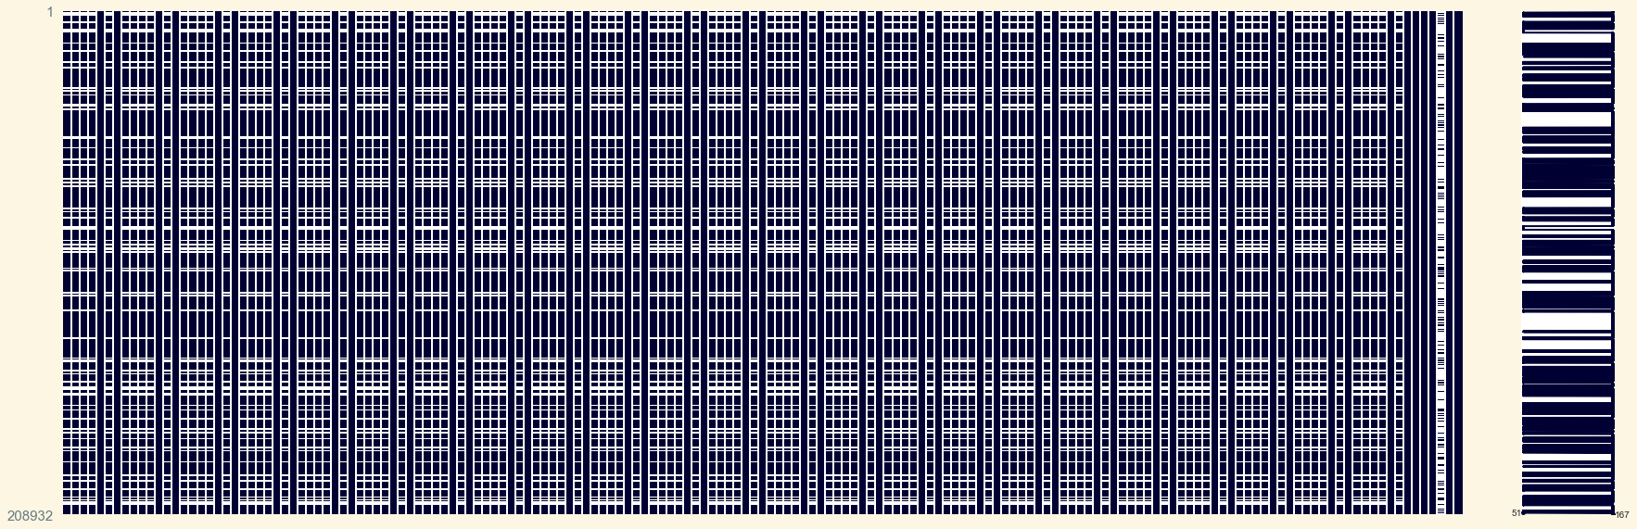
Datos nulos de toda la base: se observa que los faltantes se ubican temporalmente igual en las variables con faltantes. Esto puede ser por la falta de medición en dicha fecha.

Slide 4
Se crea un nuevo dataset donde la fecha es el índice y se agrega una variable llamada mes y un identificador de cada fila llamado “id” que puede servir para futuros merge.
date | B02_median | B06_median | B11_median | osm_id | ndvi_max | area_m2 | raster | clouds_on_raster | id | month
2017-01-03 | 0.09650 | 0.19910 | 0.18770 | 605976736 | 0.630881 | 4650.710032 | S2A_MSIL1C_20170103T142022_N0204_R010_T20JLL_2... | 0.0 | 1 | 1
2017-01-03 | 0.10660 | 0.25960 | 0.25420 | 559322368 | 0.630041 | 1502.000513 | S2A_MSIL1C_20170103T142022_N0204_R010_T20JLL_2... | 0.0 | 2 | 1
2017-01-03 | 0.11290 | 0.25550 | 0.24640 | 559322369 | 0.622036 | 2004.192528 | S2A_MSIL1C_20170103T142022_N0204_R010_T20JLL_2... | 0.0 | 3 | 1
2017-01-03 | 0.11355 | 0.29300 | 0.26675 | 559328111 | 0.669891 | 6940.507640 | S2A_MSIL1C_20170103T142022_N0204_R010_T20JLL_2... | 0.0 | 4 | 1
2017-01-03 | 0.12240 | 0.29460 | 0.28950 | 559328112 | 0.619112 | 4587.356048 | S2A_MSIL1C_20170103T142022_N0204_R010_T20JLL_2... | 0.0 | 5 | 1
... | ... | ... | ... | ... | ... | ... | ... | ... | ... | ...
2022-04-17 | 0.11270 | 0.20520 | 0.18950 | 307532496 | 0.563955 | 3824.467794 | S2A_MSIL1C_20220417T141741_N0400_R010_T20JLL_2... | 0.0 | 208928 | 4
2022-04-17 | 0.13665 | 0.23835 | 0.27315 | 307535460 | 0.490798 | 7184.535857 | S2A_MSIL1C_20220417T141741_N0400_R010_T20JLL_2... | 0.0 | 208929 | 4
2022-04-17 | 0.10625 | 0.22425 | 0.22230 | 307796387 | 0.566516 | 1147.997645 | S2A_MSIL1C_20220417T141741_N0400_R010_T20JLL_2... | 0.0 | 208930 | 4
2022-04-17 | 0.12570 | 0.20880 | 0.25450 | 307097955 | 0.534379 | 5185.690046 | S2A_MSIL1C_20220417T141741_N0400_R010_T20JLL_2... | 0.0 | 208931 | 4
2022-04-17 | 0.10180 | 0.19080 | 0.19740 | 901791744 | 0.635997 | 9394.381202 | S2A_MSIL1C_20220417T141741_N0400_R010_T20JLL_2... | 0.0 | 208932 | 4

Slide 5
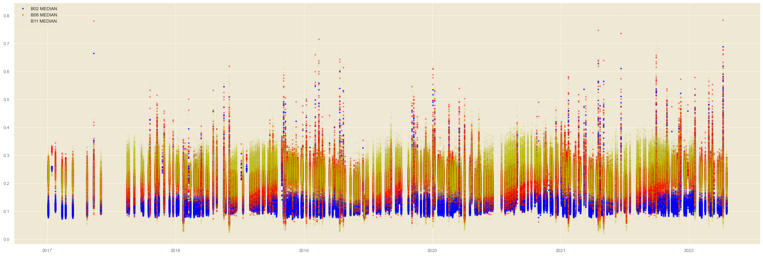
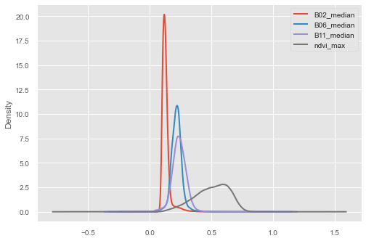
Se grafica el comportamiento de las variables B02_median, B06_median y B11_median a lo largo del tiempo (gráfico 1) y en el segundo gráfico la función de densidad de dichas variables.

Slide 6
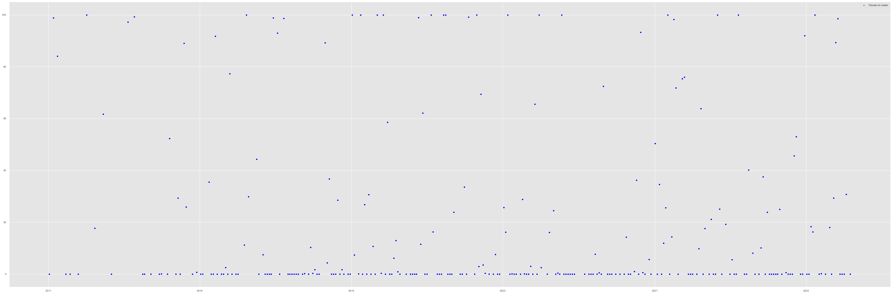
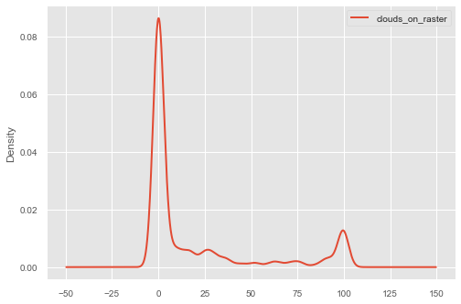
Se grafica el comportamiento de variable clouds_on_raster a lo largo del tiempo y la función de densidad para el período bajo análisis.
<Figure size 576x396 with 0 Axes>
<Figure size 576x396 with 0 Axes>

Slide 7
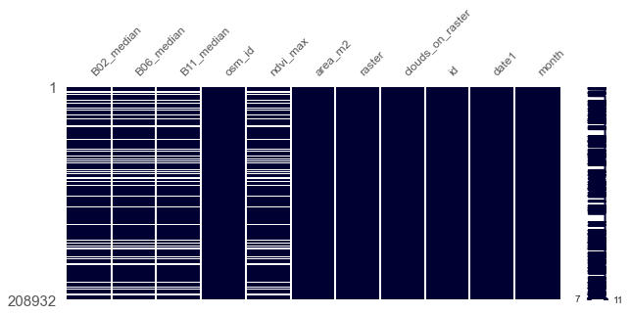
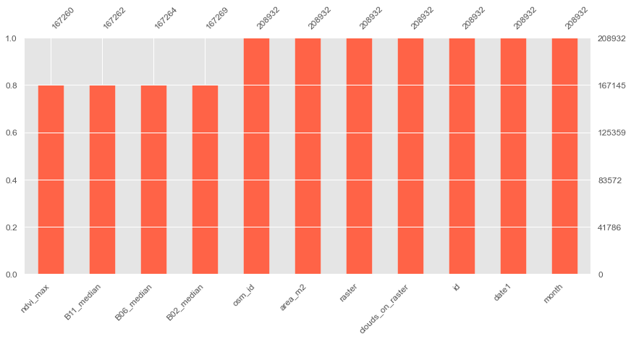
Los datos faltantes para el nuevo dataset presenta el mismo comportamiento al del dataset original

Slide 8
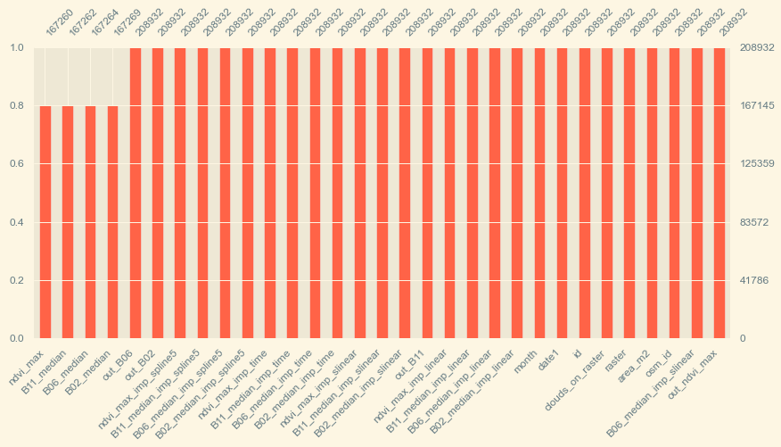
Dataset luego de la imputación con diferentes métodos: interpolación lineal, interpolación slineal, interpolación “time”, interpolación spline de grado 5.
<AxesSubplot:>
[186]:
## se guarda el archivo con los datos imputados

Slide 9
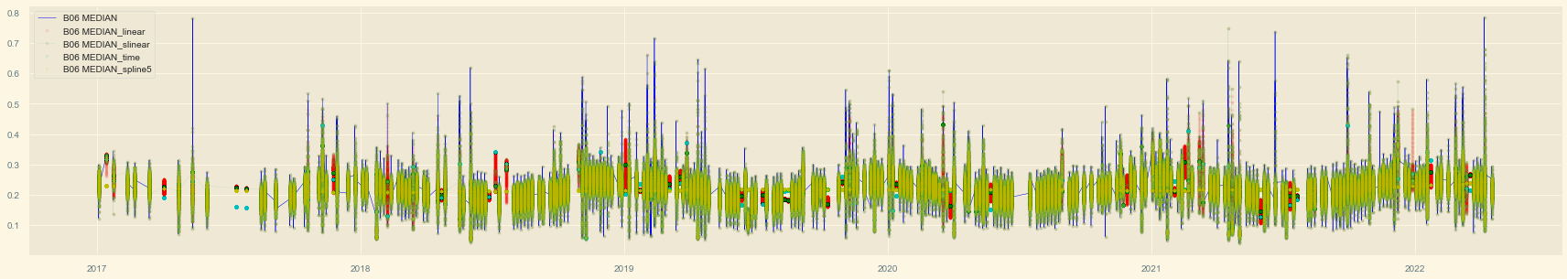
Dataset luego de la imputación con diferentes métodos: interpolación lineal, interpolación slineal, interpolación “time”, interpolación spline de grado 5.

Slide 10
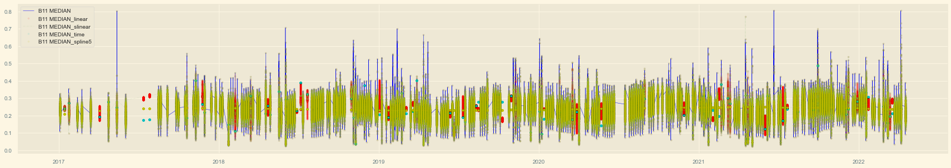
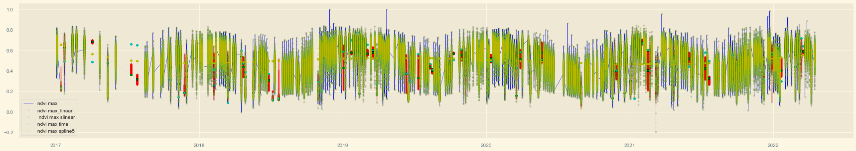
Dataset luego de la imputación con diferentes métodos: interpolación lineal, interpolación slineal, interpolación “time”, interpolación spline de grado 5.

Slide 11
Descomposición aditiva: variable B02_median imputada mediante interpolación slinear.

Slide 12
Descomposición aditiva: variable B06_median imputada mediante interpolación slinear.

Slide 13
Descomposición aditiva: evolución del componente “ruido” de la serie de tiempo para las variables B02_MEDIAN, B06_MEDIAN,B11_MEDIAN, NDVI_MAX con imputación incluida.

Slide 14
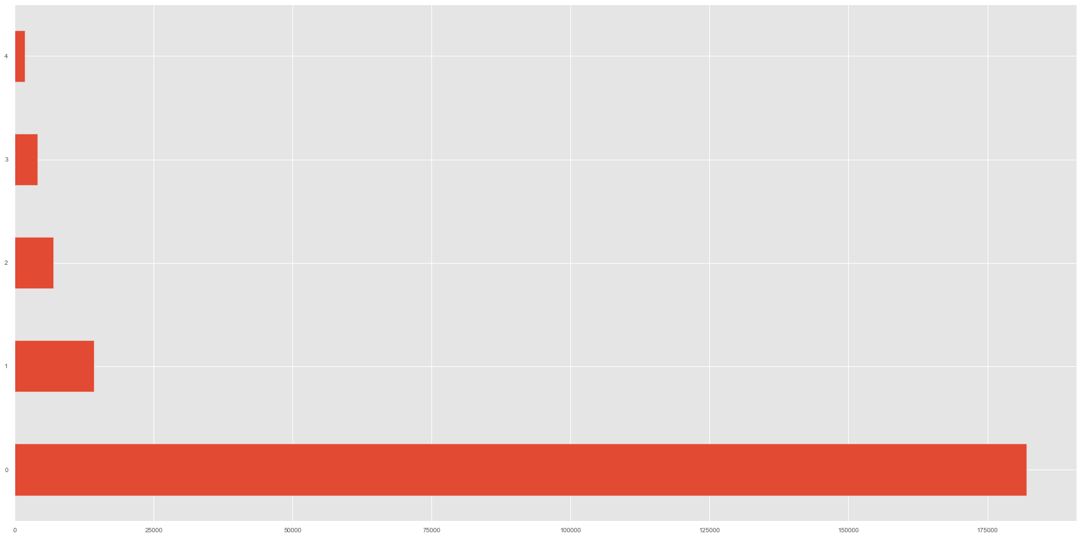
Se identifican los outliers por el método de IQR analizando el ruido. Luego se analiza la distribución de los outliers en el dataset. Se crea una variable que suma la cantidad de variables con outliers por observación y se presenta la distribución.
0 181975
1 14235
2 6879
3 4100
4 1743
N total= 208932
Finalmente nos quedamos con aquellas observaciones donde en las tres bandas como en ndvi_max era un outlier y el dataset filtrado es de 207.189

Slide 15
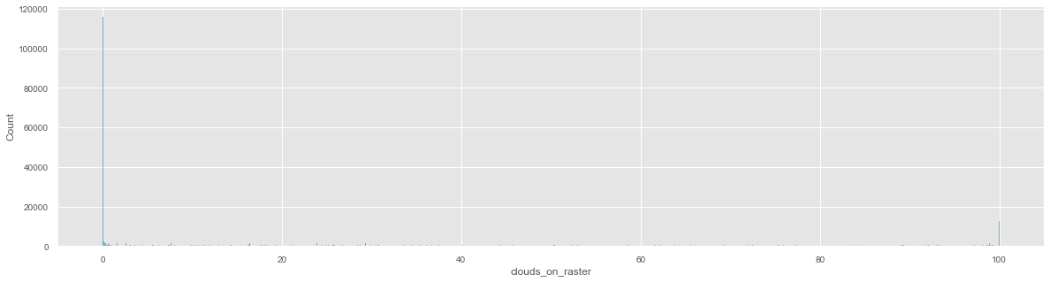
Se seleccionan aquellas observaciones con nubosidad menor a 10% a fines de seguir las instrucciones de las recetas previas y la cantidad de observaciones que quedan son 138.598.
A fines de preparar los datos para aplicar luego modelos de machine learning, se normalizan los datos con MinMaxScaler y se guarda el dataset.

